Slide 1

POL 2012: Theories and Models in Political Economy
Evolutionary economics
Espen Moe
Department of Sociology and Political Science
espen.moe@ntnu.no, #9587, 73592230

Slide 2
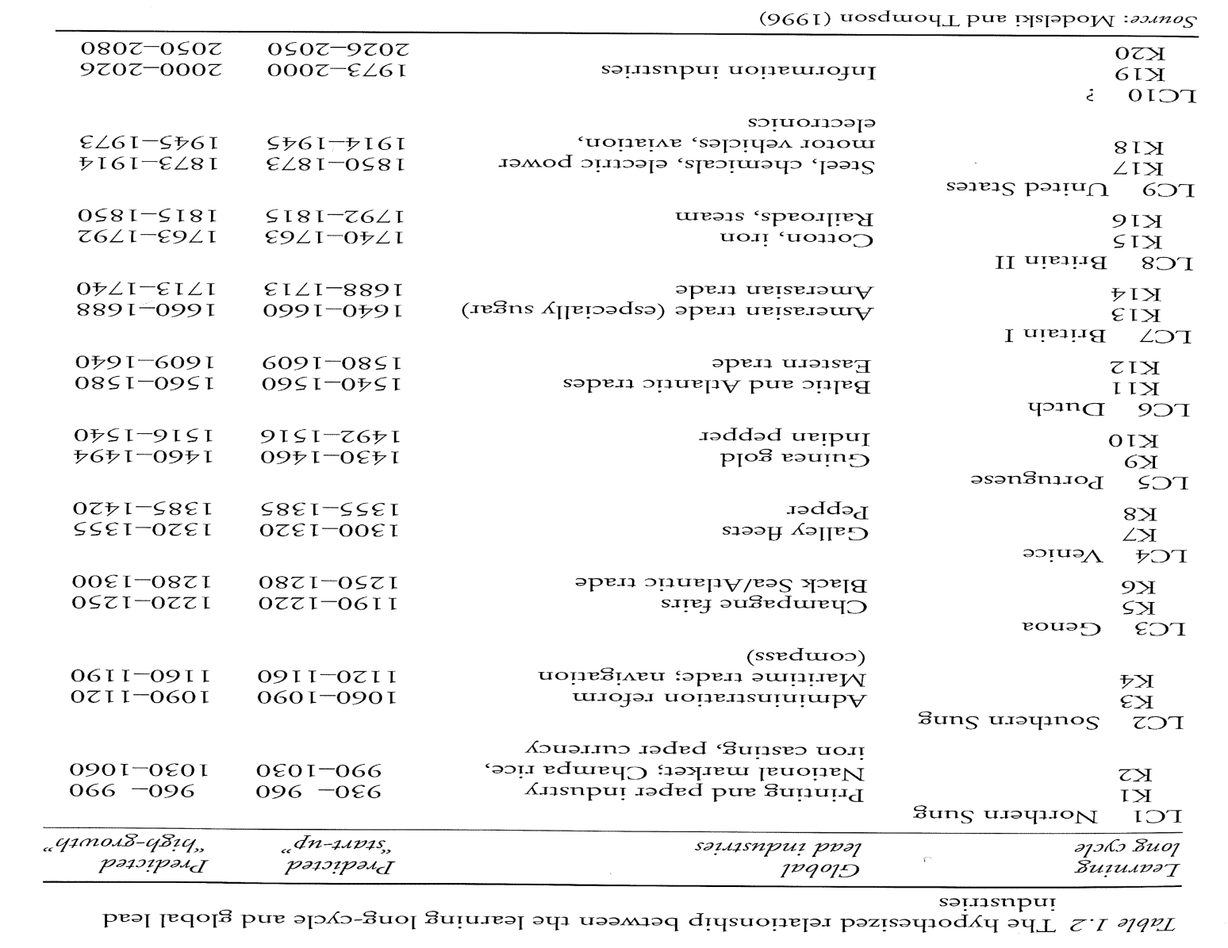

Slide 3
How have countries grown historically
Structural change
Technologically driven
Knowledge driven
Free trade?
Only a tool for the most powerful nations
Protectionist, then free trade when ready to compete
Look at the experiences of countries that have risen
Capital important?
Production capitalism vs. financial capitalism

Slide 4
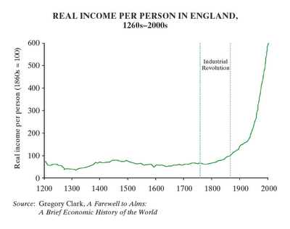

Slide 5
Tariff rates (%), some examples
 | 1820 | 1875 | 1913 | 1925 | 1931 | 1950
France |  | 12-15 | 20 | 21 | 30 | 18
Germany | 8-12 | 4-6 | 13 | 20 | 21 | 26
Denmark | 25-35 | 15-20 | 14 | 10 |  | 3
Sweden |  | 3-5 | 20 | 16 | 21 | 9
UK | 45-55 | 0 | 0 | 5 |  | 23
US | 35-45 | 40-50 | 44 | 37 | 48 | 14

Slide 6
Neo-classical/orthodox | Evolutionary
Rationality | Bounded rationality
Competition for scarce resources | Competition for scarce resources, but not static – the economy is steadily developing
Frictionless markets | Transaction costs
Full information | Asymmetric information
Free information | Information costs
No economies of scale | Economies of scale
No entry barriers | Entry barriers, typically in the shape of new technology or special skills
Equilibrium | Disequilibrium
Exchange- and trade-centered | Production-centered
Growth independent of production activity | Growth activity-specific
Technology exogenous (residual) | Technology important growth explanation
Classical growth | Collusive growth
Quantitative change | Qualitative change
Free trade mutually beneficial to all | Activity-specificity → free trade not necessarily mutually beneficial
Long-term: 5-10 years | Long-term: 50-100 years

Slide 7
Types of economic growth
Solovian
Investment based
Smithian
Trade, division of labor
Scale/scope
Schumpeterian
Human innovation, technology
Structural change
Not very important before the Industrial Revolution
Ever more important since the Industrial Revolution

Slide 8
The economy is activity-specific
Focus on production, not
exhcange
Moving up the value-chain
Example: «Resource curse»
Oil extraction; why no resource
curse in Norway?
Comparative advantage?
Microchips vs. potato chips
Monopolistic competition and
collusive growth
Entry-barriers

Slide 9
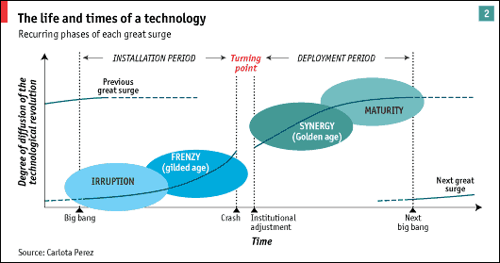
Economic growth waves

Slide 10
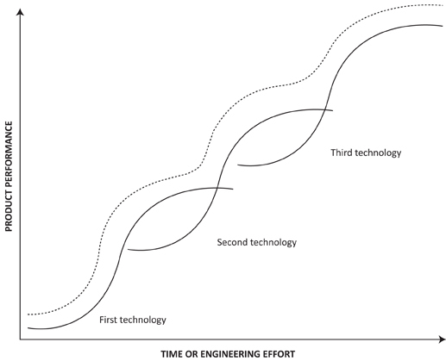

Slide 11
Criticisms
Deterministic and mechanistic?
Cycles of 50-60 years succeeding each other
Predictive power?
Better as a description of the past than a guide to the future?
Identifying past waves. Future waves harder…!
Assumes that technological progress just continue
Just accidents in history? n = 5? 6?
Not nearly as formal and analytic as neoclassical economics
How do we know…?!
Seductive, but is there any substance?
Seeing patterns that aren’t really there?
Not very strong on political and institutional mechanisms
Human capital, knowledge, innovation, technological progress

Slide 12
Joseph Schumpeter (+ Mancur Olson)
Structural change difficult! Winners and losers.
Mancur Olson, vested interests [særinteresser]
Industries that grow economically gain political influence
Influence → get favorable institutions and regulations
Eventually themselves become powerful vested interest groups
Block structural change.
New industries need other institutions/regulations
Politically risky to go against powerful vested interests.
System that «sows the seeds of its own destruction»

Slide 13
Creative destruction and institutional change
Combination of creative destruction and institutional change something that can be seen in ever more books since the financial crisis.
Often in combination with social cohesion/trust
Acemoglu & Robinson
Joel Mokyr
Ha-Joon Chang
Deirdrie McCloskey (ideas more than institutions)
Francis Fukuyama (trust and social cohesion)
Niall Ferguson (institutional degeneration)
Moe…
Keeping the economy open to change.

Slide 14
Acemoglu & Robinson
Extractive vs. inclusive institutions
S-Am vs. N-Am.
Keeping the economy open to change
Dynamic, circulation. But always an incentive to stop the dynamic when reached the top!
Incentive to go for extractive!
Schumpeter: Creative destruction
Necessary for the dynamic to continue
Necessary for the circulation of economic elites
Necessary to prevent ec elites = pol elites!

Slide 15

Schumpeter on future crises
«Will capitalism survive? No, I don’t think it can»
Schumpeter on the conditions for creative destruction to disappear
Socialization of the capitalist economy
But not socialism.
A capitalism Schumpeter hardly would have called capitalism.
Corporatization, bureaucratization
«Bureaucratic state collectivism»
Maintain living standards and industrial employment at all cost and in every industry
But also, silting up of rigidities in the system
Loses its dynamic, creativity, individualism

Slide 16
Is he right?
Rings true for the Mediterreanean countries!
Innovation and change the economic engine
Instead focus on redistribution rather than production
Huge insider-outsider problems, must be solved
But results in lower wages, higher retirement age, etc.
The left fails in keeping this sacrosanct, the right fails in thinking that this is the whole solution.
Innovation as the engine of the economy, and if the engine doesn’t re-start, then no growth…!
Politics cemented – old cleavages permanent

Slide 18
Conclusions
Schumpeterian growth
Long-run
50-100 years. Historical analysis. Path-dependencies.
Activity-specific
Free trade can be good, but not necessarily
Collusive growth
Production capital vs. financial capital
Perfect competition is good, but dynamic imperfect competition is better!
(Waves of) Creative destruction

